Slide 1
GridTalk Advance Feature

Slide 2
Feature covered:
User Procedure
Non RN connectivity: AS2/SOAP-HTTP
GT Clustering
Transaction Monitoring (TXMR)

Slide 3
User Procedure

Slide 4
GridTalk User Procedure
The user procedure module provide the platform for user to extent the functionality of GridTalk by allowing the external program to be invoked from GridTalk.
User procedure can be triggered inside the Partner Function or it can be invoked by the GridTalk scheduler.
Notes:
For example, the current GT can only export the receive document to either a local folder or a remote server folder. By using the user procedure we can upload the file to a FTP server.

Slide 5
Type of User Procedure
There are total 3 types of user procedure
Java based
Shell Executable-based
Webservice-based
Notes:
Java based: For complex business logic which is not possible implemented using shell script.
Shell Executable: Involve simple processing logic for example copy file from one location to another location or invoke third party application like .exe file.
Webservice-based: to consume the service publish by the provider

Slide 6
User Procedure: General Overview
Pass in the necessary parameter.
Dynamic value
Static value
User Procedure
Invoke External program with the passed in params
Java User procedure
Shell Executable
Web services
Based on the return value, we can
Trigger User Defined Alert
Set the return value to GDOC’s custom field for further process in Workflow.
Return value from external program
Notes:
The diagram shows the what will be expected in executed the user procedure, and what are the operation we can do base on the return value from the user procedure.
Dynamic Value can be: Extracted from GDOC, Extracted content from UDOC (Via XPATH), Attachment or pass in the entire UDOC, attachment (as a byte[] or DataHandler) to the user procedure.
Static value can be: the value defined by the User and it was hard-coded whenever the user procedure get invoked.
For example, if the return value for a FTP user procedure is ranging from 100-150, the upload is successfully, we trigger the alert to notify the user about the successfully upload status

Slide 7
User Procedure: Configuration Overview
Quick overview on Webservice User Procedure.
For complete configuration of the User Procedure, refer to GridTalk 4.0 Administration Guide.pdf secion 9.8, 9.9
Notes:
Webservice User procedure:
Sample WSDL file can be obtained from the GT server
http://localhost:8080/gridtalk/webservice/services/BackendService?wsdl
GT user procedure can extract out the available operations define in the WSDL file, and allow the user to select which operation to invoke.

Slide 8
Non RN connectivity: AS2/SOAP-HTTP

Slide 9
Non-RN Connectivity
There is quite a number of Channel Protocol in GridTalk which are RN Over HTTP, AS2 Over HTTP, Webservice over HTTP.
The following section will focus on the protocol Webservice over HTTP and AS2 over HTTP.

Slide 10
Non-RN Connectivity: Webservice over HTTP
This channel protocol (SOAP-HTTP) allow the exchange of SOAP message with the trading partner.
There is some limitation in this protocol which default assuming the trading partner is using GridTalk.
Notes:
Limitation, the web services that the default handler is consuming is the “ReceiveMessage” service exposed in GT.
This protocol is not working on GT4.0.2 due to some third party library files are missing.

Slide 11
Non-RN Connectivity: Webservice over HTTP
Even though we can override the default handler by pointing to the appropriate handler in the configuration file; however, for each web service trading partner, we need to develop a handler.
A recommend enhancement on this protocol is to follow the similar way the User Procedure provided that allow the import of TP WSDL file directly.
Notes:
The user can select which service the web service provider has exposed after importing the WSDL file, the required parameter can also be configure.

Slide 12
Non-RN Connectivity: AS2
AS2 (Applicability Statement 2) is a specification on how to transfer the document securely and reliably over the internet.
AS2 is usually use for transfering the EDI (Electronic Data Interchange) message; however it can be actually transfering any type of document.
Drummond Group is the agency to certify a particular AS2 solution to comply the AS2 standard (RFC 4130)
Notes:
Similar to RN, it has the encryption, signature etc, but the document exchange flow is not as complex as the RNIF. (RNIF has RN_ACK, RN_EXCEPTION, while AS2 only have MDN to indicate the processed status of the document.)

Slide 13
Non-RN Connectivity: AS2
GridTalk is able to send and receive the transaction message via the AS2 protocol.
The following section will show the typical send and receive scenario of a AS2 message.

Slide 14
Non-RN Connectivity: AS2, The sending of AS2 Message
GT
TP
Backend Import
AS2 Request Msg
Return MDN if required
In Synchronous/Asynchronous manner
Trigger alert & set DocTransStatus
to failed after Max Retry reached.
Resend if MDN receive timeout or
The sending to the TP failed
Alert will be trigger if the sending is failed
Notes:
This diagram shows how a AS2 Request message flow between GT and the TP.
MDN: Message Disposition Notification. Similar to the Rosettanet ACK msg
Synchronous: While synchronous MDN is required, the HTTP connection for sending out the request AS2 msg is hold till the MDN is returned from the TP.
Asynchronous: The MDN is returned in a new initiated HTTP connection from TP.
After max retry reached, the trigger alert feature is added in recently. Currently the GT402 need to be patched to achieve that.

Slide 15
Non-RN Connectivity: AS2, The sending of AS2 Message
Before sending out the AS2 msg, the AS2 identifier (similar to the Duns) for the sender and receiver will be included into the msg header.
An unique msg identifier (MESSAGE-ID) will be included in the msg header as well.
Notes:
Unique msg identifier: Purpose? If MDN is returned, we can base on the unique id in the mdn to look for the AS2 request document

Slide 16
Non-RN Connectivity: AS2, The sending of AS2 Message, Continue.
Based on the security configuration, the encryption, signing, and compression of the msg payload can be occurred in different order.
After the document sent to the TP, the ‘DateTimeSent’ field and the ‘AuditFilename’ field of OB GDOC will be set.
Notes:
For the encryption, it assure that only the sender and receiver can view the data
For the signing, it assure that only message from authenticated party are accepted.
For compression, it reduce the bandwidth needed to transfer large message payload.

Slide 17
Non-RN Connectivity: AS2, The sending of AS2 Message, Continue.
If the MDN is returned from the TP, the ‘ReceiptAuditFilename’ field of GDOC will be updated with the filename of the MDN for reference purpose.
The ‘DocTransStatus’ field of GDOC will be updated with the status indicated in the MDN.
The status will indicated that whether the TP is successfully process the AS2 message.
Notes:
If MDN is configured, and the document has sent to the TP, the ‘DocTransStatus’ will be ‘OnGoing’.
If max retry is exhausted, and MDN is configured as required. The ‘DocTransStatus’ will be updated to ‘Failed - No MDN received.’

Slide 18
Non-RN Connectivity: AS2, The sending of AS2 Message, Continue.
If no MDN is required and the AS2 Message has been sent to the TP, the ‘DateTimeSent’ field of GDOC will be updated with the timestamp that we sent the msg.

Slide 19
Non-RN Connectivity: AS2, The receiving of AS2 Message
GT
TP
Receive AS2 Request Msg
Return MDN if required
In Synchronous/Asynchronous manner
Receive the Retry AS2 Request Msg
Return MDN if required
In Synchronous/Asynchronous manner
Notes:
This diagram show how a request AS2 message flow from TP to GT

Slide 20
Non-RN Connectivity: AS2, The receiving of AS2 Message, Continue
After the receiving of the AS2 msg, it is unpacked according to the security options specified in the msg (For example signature verification, decryption).
Depending on the MDN option, a MDN may be sent back to the TP. The sent MDN will be stored in the audit file for auditing purpose. The status of processing the AS2 request msg will be included in the MDN as well.

Slide 21
Non-RN Connectivity: AS2, The receiving of AS2 Message, Continue
A received AS2 request msg may be a duplicate due to the retry from TP. If it is a retry (we base on the unique msg identifier in the msg header to determine) and MDN is required, a new MDN will be generated and delivered back to the TP.
Notes:
The update of Inbound AS2 ‘DocProcessStatus’ for example update to ‘Processed’

Slide 22
Non-RN Connectivity: AS2: The configuration for sending the AS2 request msg
Show GT configuration
Refer to GridTalk 4.0 Administrator Guide, section 16.2 Configuring AS2 Messaging

Slide 23
Non-RN Connectivity: AS2: The configuration for receiving the AS2 request msg
Show GT configuration
Refer to GridTalk 4.0 Administrator Guide, section 16.2 Configuring AS2 Messaging

Slide 24
Non-RN Connectivity: AS2: Sample AS2 Packaging
DISPOSITION-NOTIFICATION-TO: unused@unused.com
AS2-VERSION: 1.1
AS2-FROM: gt4As2
DATE: Tue, 26 Feb 2008 02:04:56 GMT
RECEIPT-DELIVERY-OPTION: http://192.168.213.111:8080/gridtalk/b2bi/rosettanet/receiver
SUBJECT: AS2 Message
MIME-VERSION: 1.0
CONTENT-TYPE: multipart/signed; micalg=SHA1; protocol="application/pkcs7-signature"; boundary="----=_Part_10_10686291.1203991496325"
MESSAGE-ID: <1115924.1203991495903.GridNode.i00104@regina>
AS2-TO: maxAs2
Connection: close
DISPOSITION-NOTIFICATION-OPTIONS: signed-receipt-protocol=optional, pkcs7-signature; signed-receipt-micalg=optional,sha1
------=_Part_10_10686291.1203991496325
Content-Type: application/XML; name=3C3_19_4.xml
Content-Transfer-Encoding: binary
Content-Disposition: attachment; filename=3C3_19_4.xml
MSG PAYLOAD
------=_Part_10_10686291.1203991496325
Content-Type: application/pkcs7-signature; smime-type=signed-data;
name=smime.p7s
Content-Transfer-Encoding: base64
Content-Disposition: attachment; filename=smime.p7s
MIIDvwYJKoZIhvcNAQcCoIIDsDCCA6wCAQExCzAJBgUrDgMCGgUAMAsGCSqGSIb3DQEHAaCCAmcw
ggJjMIIBzKADAgECAhAWQ4U+uwQasDIq8go9/2plMA0GCSqGSIb3DQEBBQUAMGYxCzAJBgNVBAYT
AlNHMRcwFQYDVQQKEw5HVDQwMiBPcmlnaW5hbDEbMBkGA1UECxMSR3JpZFRhbGsgNTE3IChHTkwp
MSEwHwYDVQQDExhHcmlkVGFsayA1MTcgQ2VydGlmaWNhdGUwHhcNMDExMjMxMTYwMDAwWhcNMTAx
MjMwMTYwMDAwWjBmMQswCQYDVQQGEwJTRzEXMBUGA1UEChMOR1Q0MDIgT3JpZ2luYWwxGzAZBgNV
BAsTEkdyaWRUYWxrIDUxNyAoR05MKTEhMB8GA1UEAxMYR3JpZFRhbGsgNTE3IENlcnRpZmljYXRl
MIGfMA0GCSqGSIb3DQEBAQUAA4GNADCBiQKBgQC9do6iKQj+6saaQZei+DT1YNoIX0gPaXS2255n
i1ZQk6BlYBFo84TUu12dbMxRx1tEUIW1SFTiZ9PwmBmOoBYeLh5J6fBxUWMbcmgfx/ZTLhE/Whli
------=_Part_10_10686291.1203991496325--
Notes:
Package as SMIME Format: Comparing to RNIF Audit File (contain, preamble, service, delivery headers), it only have one msg header
DISPOSITION-NOTIFICATION-OPTIONS: signed-receipt-protocol=optional, pkcs7-signature; signed-receipt-micalg=optional,sha1
The Receiver will sign the MDN to indicate it has received the msg. The receiver can not deny it didn’t receive the AS2 request msg before.
RECEIPT-DELIVERY-OPTION: http://192.168.213.111:8080/gridtalk/b2bi/rosettanet/receiver: Indicate the return of the MDN is in asynchronous fashion. The receiver will base on the url given to send back the MDN.

Slide 25
Non-RN Connectivity: AS2: Sample AS2 MDN Message
AS2-FROM: maxAs2
DATE: Tue, 26 Feb 2008 02:44:16 GMT
SUBJECT: AS2 MDN
MESSAGE-ID: <8479635.1203993856216.GridNode.Administrator@RN2>
AS2-TO: gt4As2
AS2-VERSION: 1.1
CONTENT-LENGTH: 2517
CONNECTION: keep-alive
CONTENT-TYPE: multipart/signed; micalg=SHA1; protocol="application/pkcs7-signature"; boundary="----=_Part_25_32143038.1203993856025"
USER-AGENT: Java/1.5.0_05
HOST: 192.168.213.111:8080
ACCEPT: text/html, image/gif, image/jpeg, *; q=.2, */*; q=.2
------=_Part_25_32143038.1203993856025
Content-Type: multipart/report; Report-Type=disposition-notification;
boundary="----=_Part_21_3760770.1203993855895"
------=_Part_21_3760770.1203993855895
Content-Type: text/plain
Content-Transfer-Encoding: 7bit
MDN for -
Message-Id: <1115924.1203991495903.GridNode.i00104@regina>
From: gt4As2
To: maxAs2
Status: processed

Slide 26
GT Clustering

Slide 27
Clustering GridTalk
The GT cluster can be view as a group of GT that work together.
The cluster can ensure
High availability
Load balancing
Scalability
Notes:
THEORY ☺
High availability a.k.a the fail over mechanism can guarantee the availability of GT services to be 99 % up and running
The load balancing can improve the GT processing performance by sharing the workload among the available node in the cluster
The scalability provides the capability of future handling the additional large volume of transaction by deploying more node into the cluster.

Slide 28
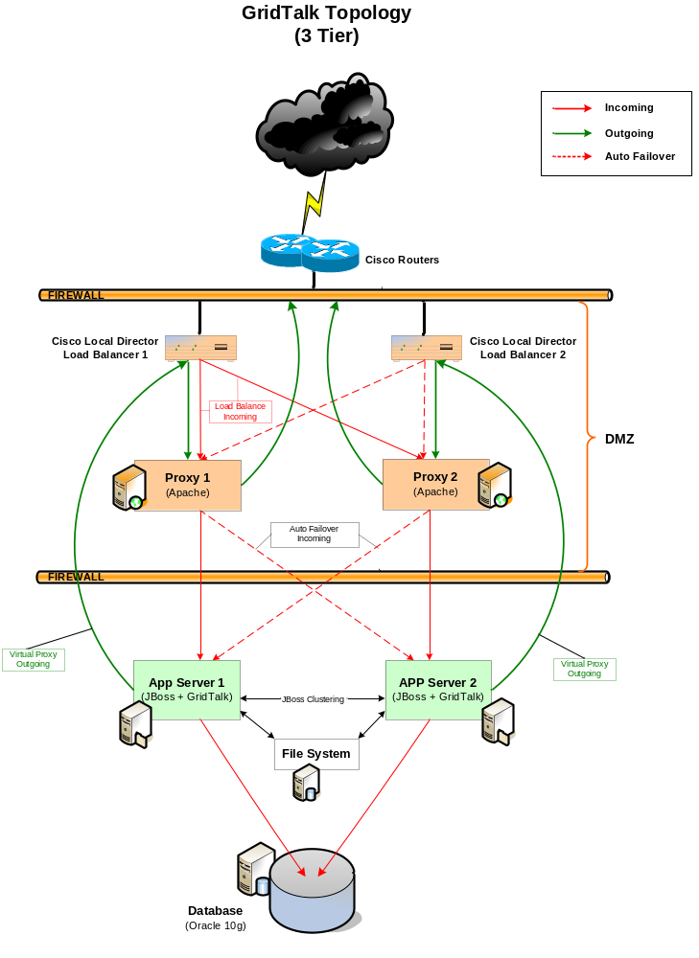
Clustering GridTalk Topology
Presentation tier: Web Browser (GT WEB GUI + TXMR GUI)
Logic Tier: RNIF, AS2 Processing
Data Tier: File System & Database
Notes:
In term of a RNIF/AS2 document exchange, it is a 2-tier design. If the user accessing the GT GUI, it will be a 3-tier design (if we further separate out the web server to a independent design, it will be a 4-tier design).
Cisco hardware load balancer: It will dispatch the HTTP request to the proxy server in Round-Robin Fashion.
Apache Proxy server: It functions as HTTP proxy for both incoming & outgoing HTTP request. The proxy server will fail over the HTTP request to the other APP server in case a particular APP server is not available. The proxy server will stick to a particular APP server. Meaning proxy server HTTP request will always forward to the APP server1.
JBOSS AS: This is where GT is deployed and the APP server form a cluster. (mainly achieve via JBOSS HA-JMS)
File System: Share file system for the available node in the cluster
Oracle Database: Centralise DB which will be accessed by the available node in the cluster.
FYI:
The cisco hardware load balancer may not needed. The setup of in house dev only contain a Proxy server which functions a load balancer and fail over of the HTTP request to the App server.

Slide 29
Transaction Monitoring (TXMR)

Slide 30
Transaction Monitoring (TXMR)
TXMR provides us a channel to monitor the private processing of a transaction message. The public processing (RNIF) monitoring is also included.
It help us to identify the status of the transaction message by providing the life cycle of the message.

Slide 31
Transaction Monitoring (TXMR)
Features includes
The reprocessing of a particular transaction.
The report generating
Transaction Message life cycle tracking
Allow fast tracking on the Process Instance
Notes:
Reprocessing IB & OB: in case the export of the incoming msg to backend is failed, we can re-execute the corresponding partner function without doing a manual way. In case of outgoing transaction fail (for example mapping rule failed), we can restart the partner function activity without the need to re-import from customer backend.
Report generation: Provide the statistic on the number of successful/abnormally completed process instance from/to a particular TP
Life cycle tracking: It keep track the process/activity we perform on the transaction message for example ‘Unpackaging’, ‘Mapping Rule’, ‘Exit to Port’, ‘Document Deliver’ status etc
Fast tracking: Compare to the GT gui, if we need to search the process instance on a particular day, we are not able to do that. GT GUI is not supporting the searching of Process Instance base on date range.

Slide 32
Transaction Monitoring (TXMR)
For the complete user guide of the TXMR, refer to \\nas-etrade\releases_prd\gridtalk\GT41X\GT413\TXMR_User_Guide_r1.1.pdf

Slide 33
GridTalk Advance Feature
End, Thank you

